Slide 1
Tuesday, 16 February 2021
Coasts
Lesson Objective:
To revise ‘Coasts’ key terms.
To revise key content for ‘Coasts’
To revise key theories and case studies.
Starter:
Create a spider diagram for the ‘Coasts’ topic.
Try to include as many key terms, theories and case studies as you can remember.
Share with your partner, can you add anything.
Coasts

Slide 2
Key Issues
Weathering
Beach Formation
Cliff Collapse
Spit/Bar
Holderness
Wave Cut Platforms
Coastal Defences
Waves

Slide 3

1) Weathering
What do you remember about Weathering?

Slide 4
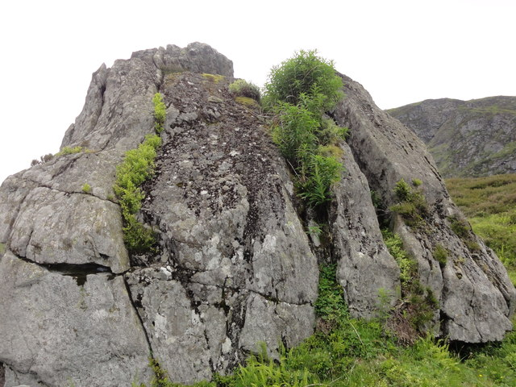

1) Weathering
In the exam you are expected to be able to explain the 3 different types of weathering; Physical, Chemical and Biological.
Task 1: Complete the sheet to show your understanding of weathering and its affect on the coast.
Help Desk:
Text book
Challenge:
Identify and explain how other factors affect the coast.

Slide 5
2) Beach Formation
What do you remember about beach formation?

Slide 6
2) Beach formation
A sloping area of sand or shingle across the entrance to a bay or river mouth.
What is a beach?
Draw a labelled diagram to show the formation of a beach. (4 marks)
Explain the formation of a beach. (4 marks) (Complete the sheet to show the correct answer).
Deposition is the main process responsible for the formation of a beach. For this to occur, waves must have limited energy and so beaches often form in sheltered areas such as bays where wave energy is less than on exposed headlands. Here, waves are likely to be constructive where the swash is dominant and the backwash weaker so that material is left on the beach rather than being taken away by the waves.
Help Desk:
Text book Google Drive
Challenge: How is the formation of a beach different to the process of longshore drift.

Slide 7
3) Cliff Collapse
What do you remember about Cliff Collapse?

Slide 8
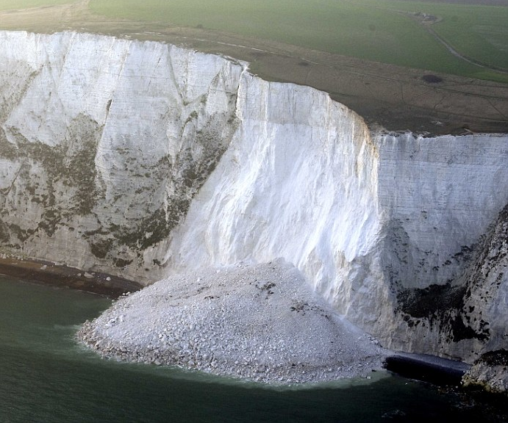
3) Cliff Collapse
Task 1: What is cliff collapse. HINT: Do not use the words in the questions.
Task 2: Explain the 3 key mass movements (fall, slump, slide).
Task 3: Answer the following question “Explain why cliffs collapse?” (4 marks)
Help Desk:
Mass movement/cliff collapse help sheet
Google Drive
Challenge: Explain how cliff collapse is different from the formation of a wave cut platform.

Slide 9
5) Spit/Bar
What do you remember about spits and bars?

Slide 10

5) Spit/Bars
In the exam you are expected to be able to draw and explain the formation of a spit. In addition to being able to describe the difference between a spit and a bar.
Task 1: Draw an annotated diagram showing the formation of a spit. Ensure to label its characteristics/features.
Task 2: Explain the formation of a spit. (4 marks)
Task 3: Outline the difference between a spit and a bar.
HINT:
Think about to Water on the Land for meaning of Characteristics.
Help Desk:
Basic diagram of a spit and a bar
Text book)
Google Drive
Challenge: Explain why spits can be different sizes and shapes.

Slide 11
7) Wave Cut Platforms
What do you remember about wave cut platforms?

Slide 12
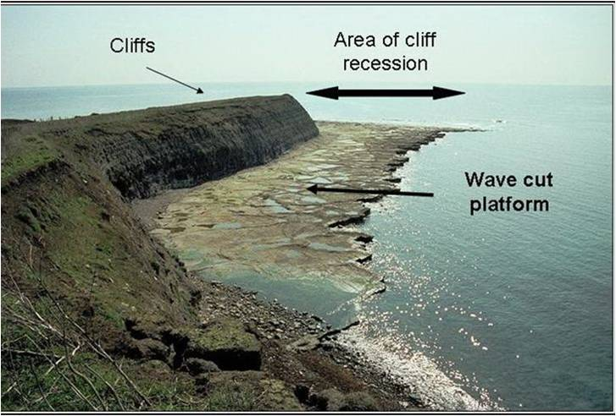
7) Wave cut platform
In the exam you are expected to understand what a wave cut platform is, in addition to how they are formed.
Task 1: Draw an annotated diagram to show the formation of a wave cut platform
Task 2: Explain the formation of a wave cut platform. (4 marks)
Help Desk:
Labels belonging on a diagram
Text book
Google Drive
Challenge: With the use of a diagram explain the formation of a stump.

Slide 13
8) Coastal Defences
What do you remember about Coastal Defences?

Slide 14
8) Coastal Defences
In the exam you are expected to understand the costs and benefits of coastal defences. Particular focus on the comparison between hard and soft engineering.
Task: Complete the sheet to show your understanding of 6 different coastal defences. (Can you complete it without the use of the help sheet).
Challenge: Discuss which type of engineering is most beneficial for protection against coastal flooding. (6/8 marks)
Attempt to complete the sheet without the help desk first.
Help Desk:
Information on the coastal defences
Text book (pg 124-125)
Google Drive

Slide 15
9) Waves
What do you remember about Waves?

Slide 16
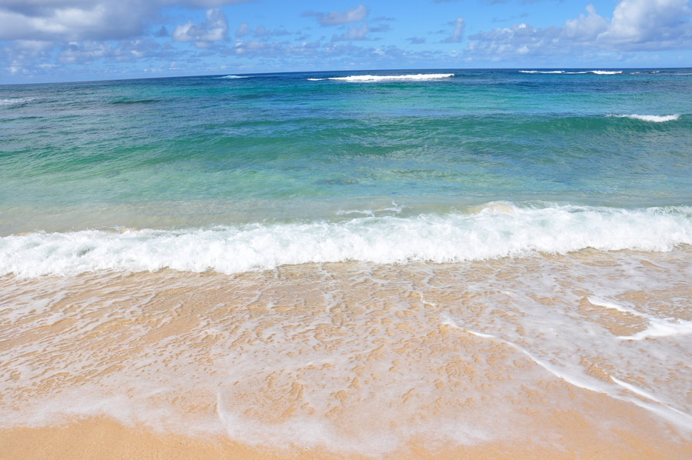
9) Waves
Task 1: Explain how waves are formed. (4 marks)
Task 2: What is swash and backwash.
Task 3: Label the constructive and destructive wave.
Task 4: Explain why one type of wave is associated with coastal erosion and the other with deposition. (4 marks)
Help Desk:
Text book (pg 116-118)
Google Drive
Challenge: Explain why the sea deposits material. (3 marks)

Slide 17


Tuesday, 16 February 2021
Coasts
Lesson Objective:
To revise ‘Coasts’ key terms.
To revise key content for ‘Coasts’
To revise key theories and case studies.
Starter:
Write down 3 elements of Coasts that you would feel confident about if it appeared in the exam.
Write down 3 elements of Coasts that you would not feel confident about if it appeared in the exam.

Slide 18
Key Issues
Weathering
Beach Formation
Cliff Collapse
Spit/Bar
Holderness
Wave Cut Platforms
Coastal Defences
Waves

Slide 19
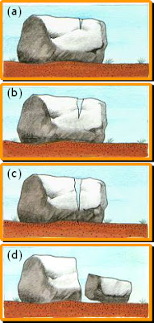
Weathering
Weathering means……………………………………………………………………………………………………………………………………………………………….
Physical weathering:
What type of weathering is pictured below?
………………………………………………………………………………
Chemical Weathering
This happens when the rock’s mineral composition is changed, leading to the disintegration of the rock. The main process of chemical weathering is............................. and this happens in ...................... rocks.
Explain what is happening at each stage:
_____________________________________________________________________________________________________________________________________________________________________________________________________________________________________________________________________________________________________________________________________________________________________________________________________________________________________________________________________________________________________________
Biological Weathering
This is caused by plants and animals.
Explain how both of these cause biological weathering.
____________________________________________________________________________________________________________________________________________________________________________________________________________________________________________________________________________________________________________________

Slide 20
Explain the formation of a beach. (4 marks) (Complete the sheet to show the correct answer).
Deposition/Erosion is the main process responsible for the formation of a beach. For this to occur, waves must have excess/limited energy and so beaches often form in open/sheltered areas such as bays/headlands where wave energy is less/more than on exposed bays/headlands. Here, waves are likely to be constructive/destructive where the backwash/swash is dominant and the backwash/swash stronger/weaker so that material is left on the beach rather than being taken away by the waves.
Explain the formation of a beach. (4 marks) (Complete the sheet to show the correct answer).
Deposition/Erosion is the main process responsible for the formation of a beach. For this to occur, waves must have excess/limited energy and so beaches often form in open/sheltered areas such as bays/headlands where wave energy is less/more than on exposed bays/headlands. Here, waves are likely to be constructive/destructive where the backwash/swash is dominant and the backwash/swash stronger/weaker so that material is left on the beach rather than being taken away by the waves.

Slide 21
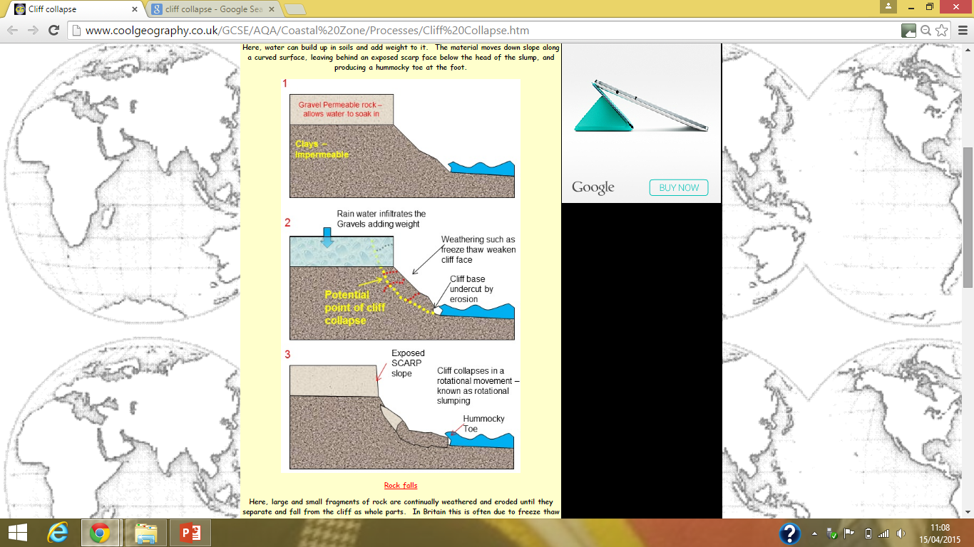
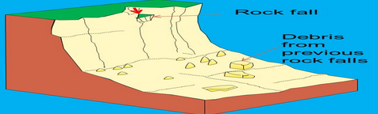
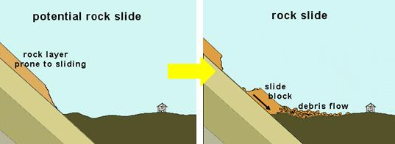
Mass Movement
Cliff collapse for a number of reasons, including the rate and type of weathering acting upon the front edge of the cliff or the cliff face, human activity located on the top of the cliff and the rate and type of erosion occurring at the cliff base. These processes are dependent upon various factors including: the size and power of the waves attacking the coastline, the material that makes up the coastline, the structure of the rock and the climate of the area.
Cliffs can collapse in a number of different movements, called Mass Movement.
Slumping
Here, water can build up in soils and add weight to it. The material moves down slope along a curved surface, leaving behind an exposed scarp face below the head of the slump, and producing a hummocky toe at the foot.
Rock Falls
Here, large and small fragments of rock are continually weathered and eroded until they separate and fall from the cliff as whole parts. In Britain this is often due to freeze thaw weathering.
Land Slides
Where rocks are laid down in beds that slope (dip) down towards the sea, whole layers can slide down the slope along a slide plane.

Slide 22
London and the Thames Estuary– Case study
1953 Thames flooding:
Problems
Social | Economic | Environmental | Political
Soluion:

Slide 23
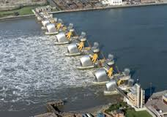
London and the Thames Estuary – Coastal Flooding
3) The Coastal Zone
Where: London and the Thames estuary (including central London)
What: Terrible flooding in 1953 from a storm surge from the North Sea. The storm surge coincided with high spring tides. Canvey island was worst effected.
Why is the area at risk: Low lying coastal area, at risk from storm surges
What are the impacts of coastal flooding in London and the Thames Estuary:
  It would be a financial disaster
  1.5 million commuters work in the Thames Estuary
  Property is worth around £100 billion
  1.25 million people live in the Thames flood zones
  69 tube stations, 400 schools and 16 hospitals are also in the zone
  Infrastructure value is too high to calculate
What methods/strategies have been put in place to reduce these impacts.
  Thames Barrier was built (1984)
  Cost £534 million
  Raised 4-6 times a year, but this is increasing
  2007 it was closed 2007
  Thames barrier is expected to cope until 2030-50
How effective are the methods (e.g. in terms of costs and benefits, or sustainability)?
It has been successful, but it is being closed more frequently, costing lots of money.
Thames barrier is expected to cope until 2030-50 so is not fully sustainable in the long term
How might the area be managed more sustainably in future?
New proposal for a 16km wide barrier across the river (from Sheerness in Kent to Southend in Essex)

Slide 24
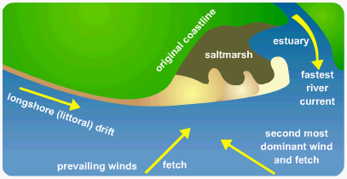
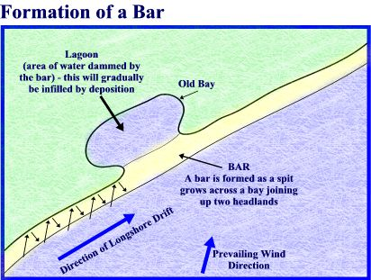

Slide 25
High tide
Low tide
High tide
Low tide
High tide
Low tide
Between high and low tide rocks are hurled at the base of the cliff- called corrasion.
Between high and low tide rocks are hurled at the base of the cliff- called corrasion.
Between high and low tide rocks are hurled at the base of the cliff- called corrasion.
This creates a wave cut notch, the cliff has been undercut.
This creates a wave cut notch, the cliff has been undercut.
This creates a wave cut notch, the cliff has been undercut.
The top of the cliff becomes unstable.
The top of the cliff becomes unstable.
The top of the cliff becomes unstable.
This overhang will collapse into sea providing more material for corrosion.
This overhang will collapse into sea providing more material for corrosion.
This overhang will collapse into sea providing more material for corrosion.
The cliff has now retreated. The process of corrasion will continue.
The cliff has now retreated. The process of corrasion will continue.
The cliff has now retreated. The process of corrasion will continue.
Because there can be no erosion below low tide a rock platform is left- called a wave cut platform- this is exposed at low tide.
Because there can be no erosion below low tide a rock platform is left- called a wave cut platform- this is exposed at low tide.
Because there can be no erosion below low tide a rock platform is left- called a wave cut platform- this is exposed at low tide.
Wave cut platform
Wave cut platform
Wave cut platform

Slide 26
